Slide 1
Astro Sage Call Center Operations Optimization
Investment Utilization & Performance Improvement Project

Slide 2

Prepared By:
Mohammed Yasin Shaikh

Slide 3
Problem Statement
Astro Sage operates a complex multi-channel call center serving thousands of customers daily. Rising customer expectations, seasonal demand volatility, and operational inefficiencies threaten profitability. This analysis identifies performance gaps and recommends a ₹1 Crore strategic investment to optimize operations and enhance customer satisfaction.

Slide 4

Data Overview:
Data Summary A total of 2,790 distinct users have been assisted by 305 experts. This encompasses 34 days of data collected from India. There have been 8,512 total calls (41% successfully completed, 14% unsuccessful, and 10% incomplete). The data is utilized to examine customer trends and enhance operational efficiency.

Slide 5
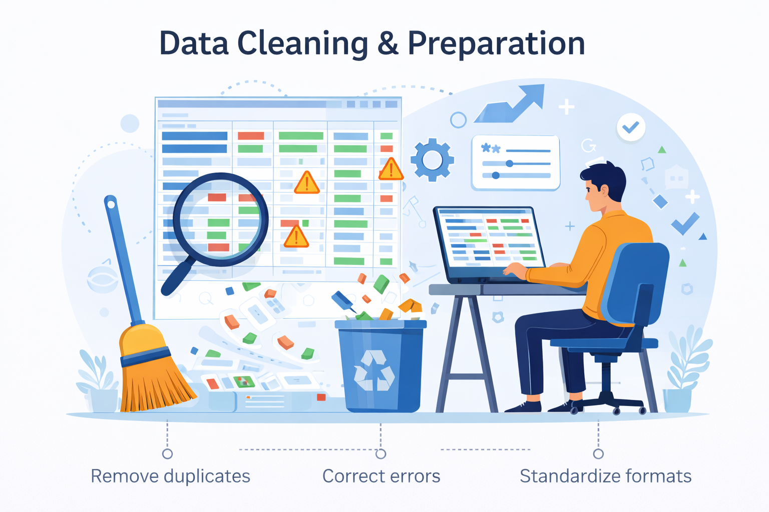
Data Cleaning & Preparation
Address absent values and empty data cells throughout the dataset. Standardized date values into day, month, and year formats for daily, monthly, and yearly reports. This dataset facilitates a comprehensive understanding of Astros age's market presence and operational scope. A robust dataset is crucial for analyzing operational costs, customer satisfaction, and trends in call center sales. This dataset empowers us to forecast and recommend future investments to enhance sales turnover.

Slide 6
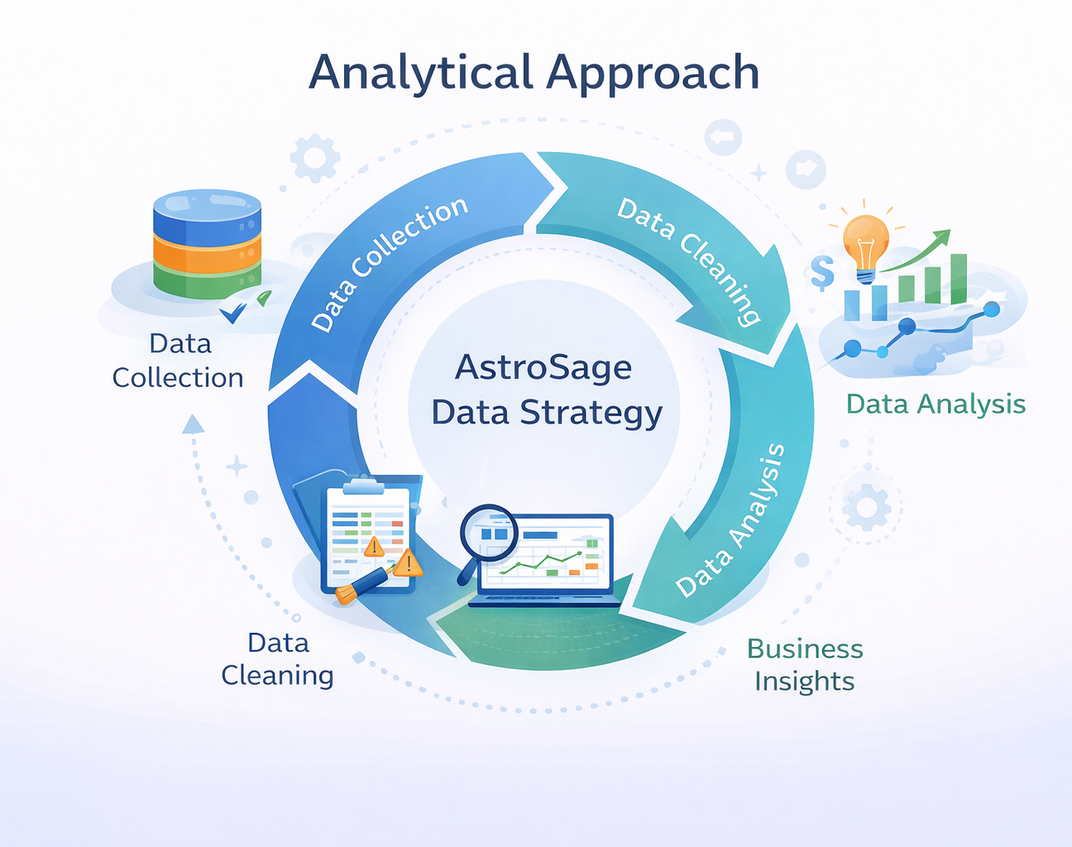
Analytical Approach
Data Cleaning - Utilized spreadsheet functions such as trim and Eliminating duplicates for the purpose of data cleaning.
Data Enrichment - Incorporated new variables through Date functions to enhance analysis.
Customer Segmentation - Employed Sorting and Filtering techniques to categorize customers according to consultation type, while summarizing key metrics and recognizing connection patterns across various metrics and product categories.
Visualization - Developed an interactive dashboard utilizing diverse charts for a comprehensive view of the dataset.

Slide 7
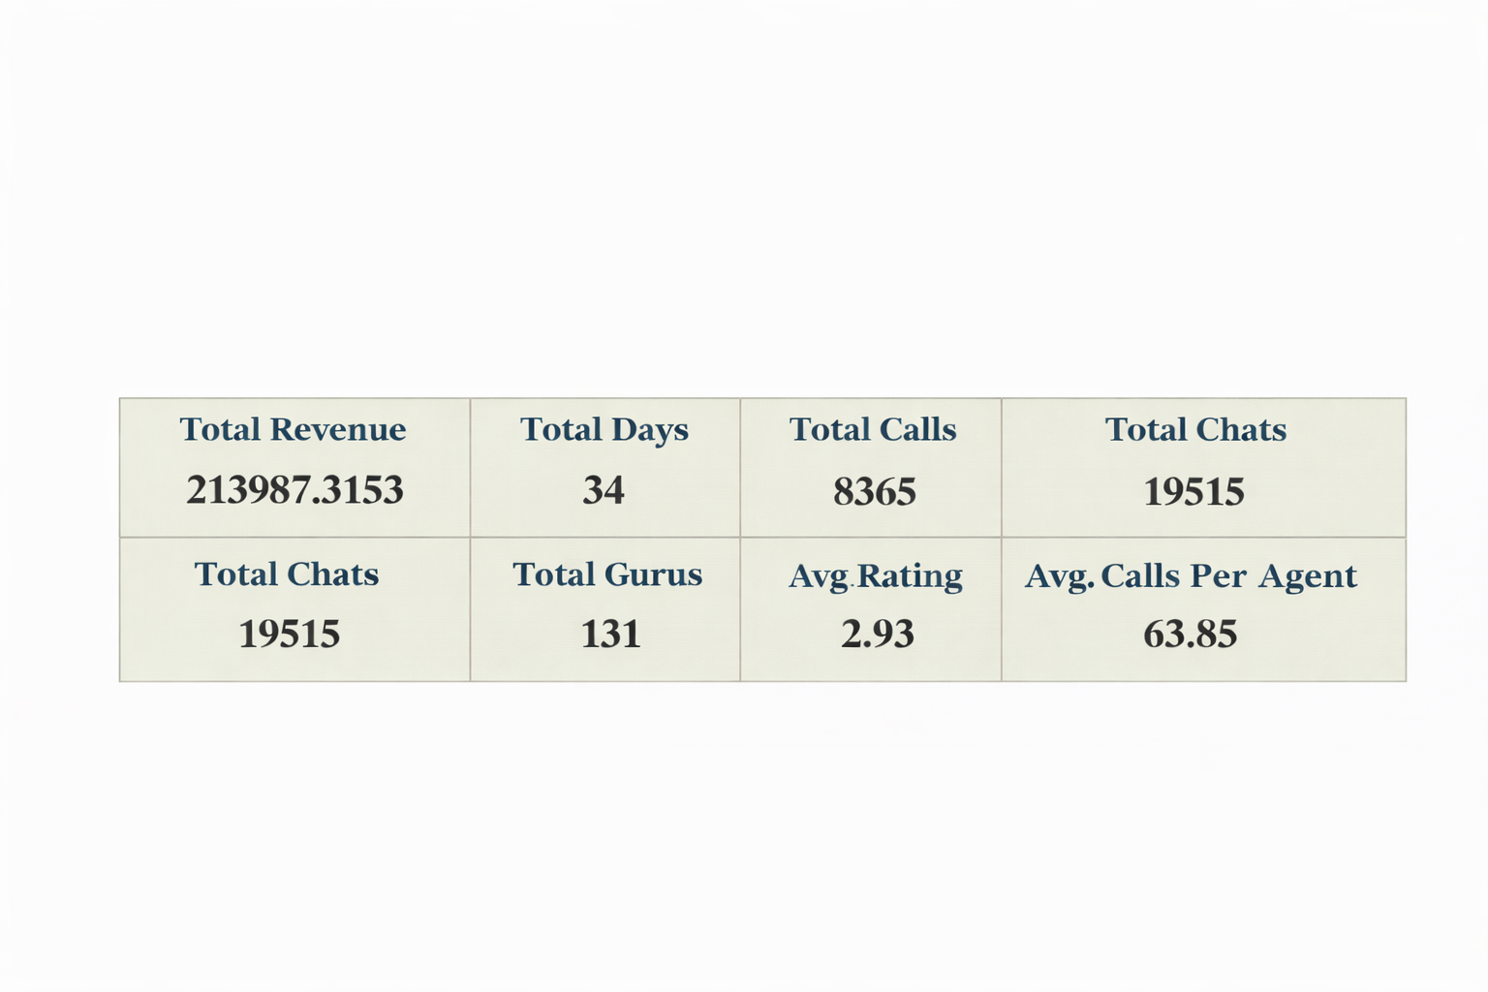
Dashboard Walkthrough
The interactive dashboard offers a consolidated perspective on call center performance, focusing on essential operational KPIs.
Metrics Presented
Total Revenue & Agent Earnings
Total Calls & Chats
Total Active Gurus
Average Customer Rating
Average Calls per Agent

Slide 8
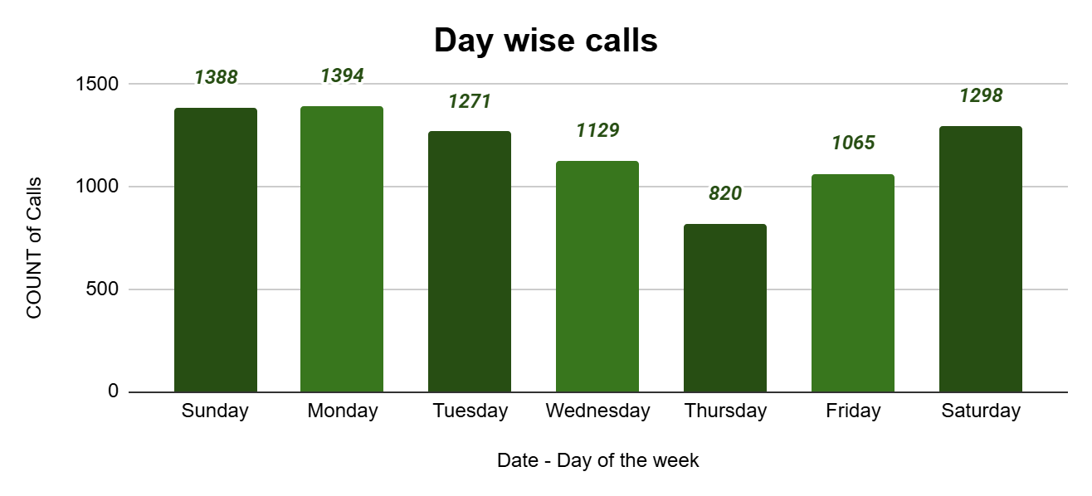
Day Wise Change in Call Volume
The volume varies from day to day, exhibiting significant fluctuations following peak days.
The most substantial increases are noted around mid-December, suggesting heightened customer engagement prior to the end of the month.
There is a steady decline as the month concludes and into early January, reflecting a period of reduced workload.

Slide 9
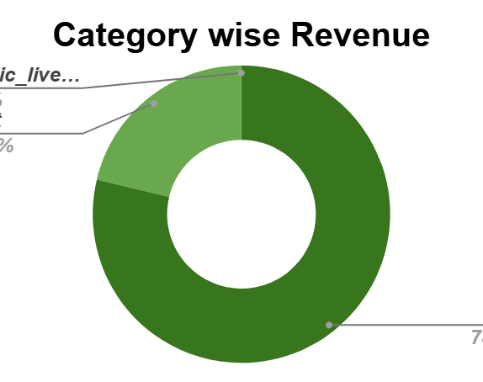
Revenue Generated By Each Category
Diverse revenue channels indicate the growing profitability of chat services and the fundamental strength of call centers. 50.597
The call channel accounts for the largest share of revenue, surpassing all other earnings.
Chat and public live call channels produce smaller revenue streams, yet they enhance user engagement.
Supplementary consultations do not yield direct revenue but assist in generating leads and retaining customers.

Slide 10
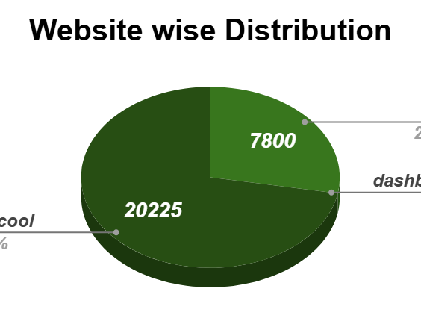
Website Distribution
Guru Cool accounts for approximately 72% of all interactions (20,225), establishing it as the main customer touchpoint.
The mobile application represents around 28% (7,800), demonstrating significant adoption while also indicating opportunities to enhance the mobile-first experience.
Usage of the dashboard is limited, suggesting a low dependence on web-portal support and highlighting potential for optimization or resource reallocation.

Slide 11
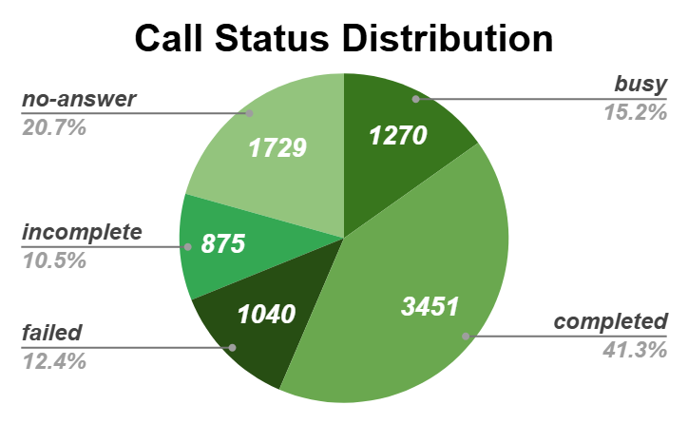
Call Status Distribution
Analysis of call completion rates and failure metrics highlights challenges related to service quality and infrastructure.
The majority of calls are successfully completed, reflecting the efficiency of the system or agents involved.
A notable proportion of busy and incomplete calls indicates a potential for enhancing call handling and routing processes.
The presence of failed and unanswered calls suggests opportunities for revenue recovery and areas for improvement.

Slide 12
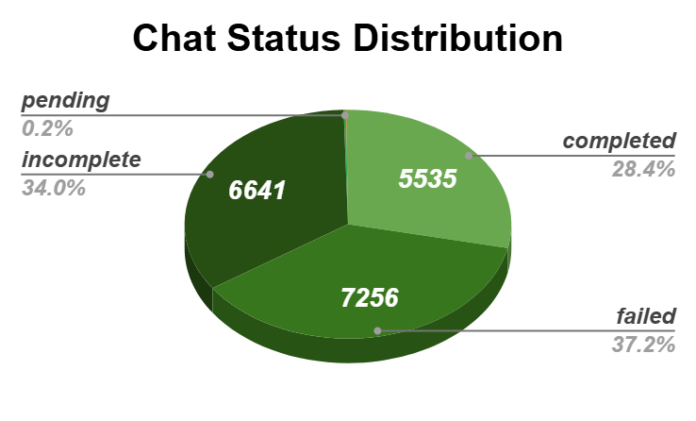
Chat Status Distribution
Chat completion rates and failure analysis indicate challenges in service quality and infrastructure.
The majority of chats are successfully completed, which demonstrates robust handling of chat support.
A significant number of pending and initiated chats suggest opportunities to enhance the speed of chat resolution.
The rates of failure and incompletion are relatively low, indicating efficient chat workflows.

Slide 13
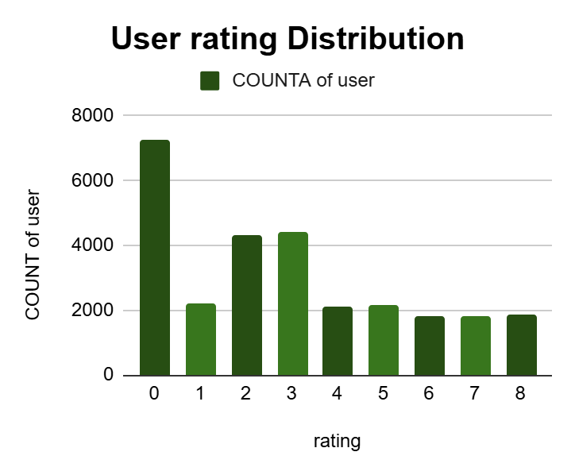
Guru Evaluation Score: 8 out of 8
The column chart illustrates the distribution of users based on their ratings.
Call consultations necessitate enhancements to improve the overall quality of user experience.
User ratings for chat consultations are relatively higher than those for call consultations.

Slide 14
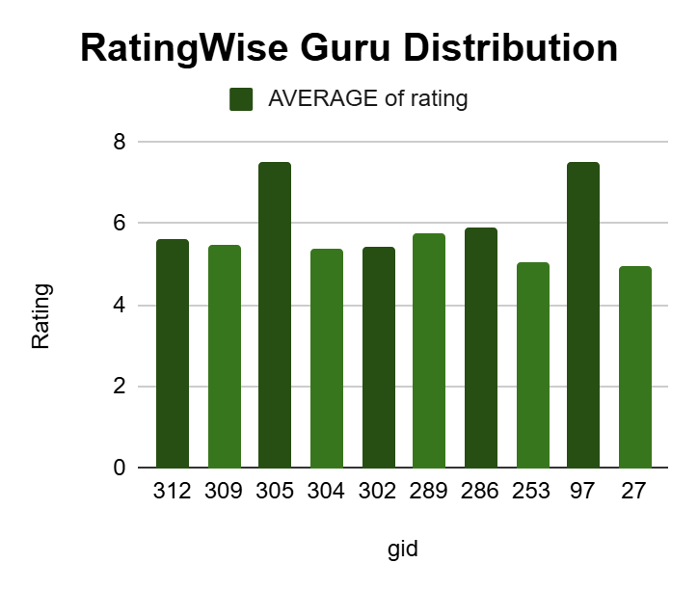
Rating Wise Guru Distribution
Leading agents consistently achieve ratings between 7 and 8, indicating a high level of service quality.
Performance gradually declines after the top agents — a skill gap is evident among lower-ranked agents.
Emphasizes the opportunity to reward top performers and provide training for lower-tier agents to ensure consistency.

Slide 15
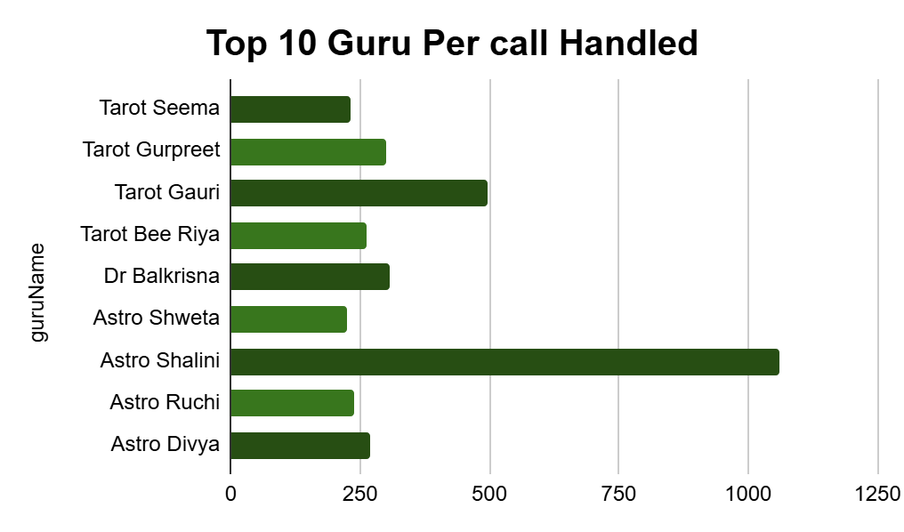
Top 10 Agents (By Performance)
Astro Shalini is significantly ahead, managing more than twice the calls of any other Guru — indicative of her strong expertise and the trust she has garnered from customers.
The distribution of calls is markedly imbalanced, indicating a necessity to equalize the workload and ensure consistent service quality.
This trend underscores the potential for mentorship, allowing top performers to enhance the overall efficiency of the team.

Slide 16
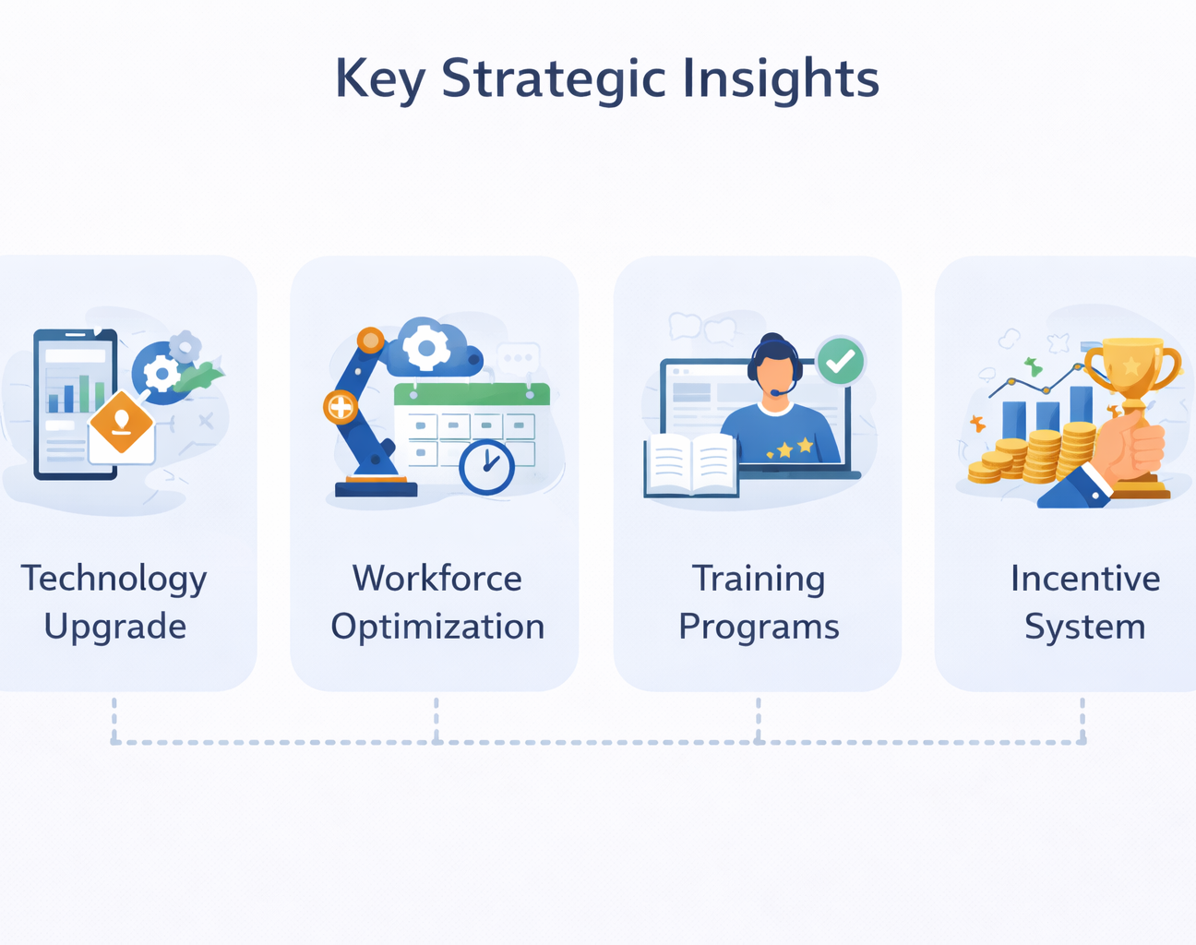
Key Strategic Insights
Modernize Technology Infrastructure:
Implement a cloud-based omnichannel platform to reduce call and chat failures and improve customer experience.
Optimize Workforce Management:
Use AI-driven scheduling and forecasting to align staffing with peak demand periods.
Enhance Employee Capabilities:
Provide continuous training and certification programs to improve service quality and customer engagement.
Strengthen Revenue Channels:
Stabilize call operations while improving chat performance to maximize revenue growth.
Leverage AI and Analytics:
Deploy AI chatbots and real-time dashboards for faster responses and data-driven decision-making.
Introduce Performance-Based Incentives:
Reward top performers to improve productivity, motivation, and employee retention.

Slide 17
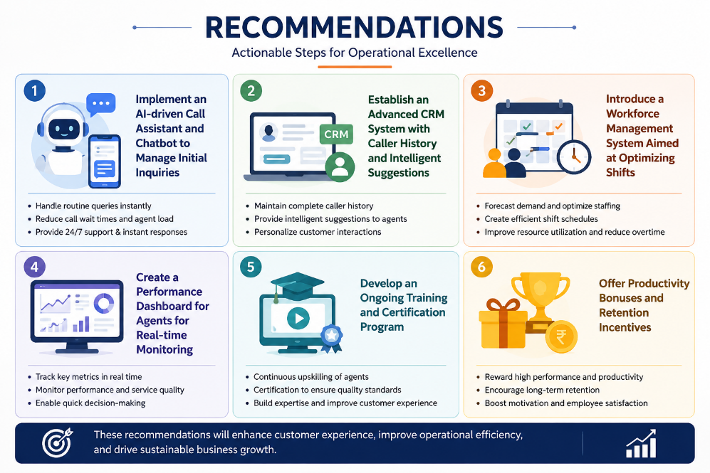
Recommendation
Implement an AI-driven call assistant and chatbot to manage initial inquiries
Establish an advanced Customer Relationship Management (CRM) system featuring caller history and intelligent suggestions
Introduce a workforce management system aimed at optimizing shifts
Create a performance dashboard for agents to facilitate real-time monitoring
Develop an ongoing training and certification program
Offer productivity bonuses and retention incentives

Slide 18

Conclusion
The analysis identified key opportunities to improve AstroSage's call center performance by reducing call and chat failures, optimizing workforce utilization, enhancing service quality, and leveraging technology-driven solutions. Implementing these improvements can strengthen customer satisfaction, increase operational efficiency, and support sustainable revenue growth.

Slide 19
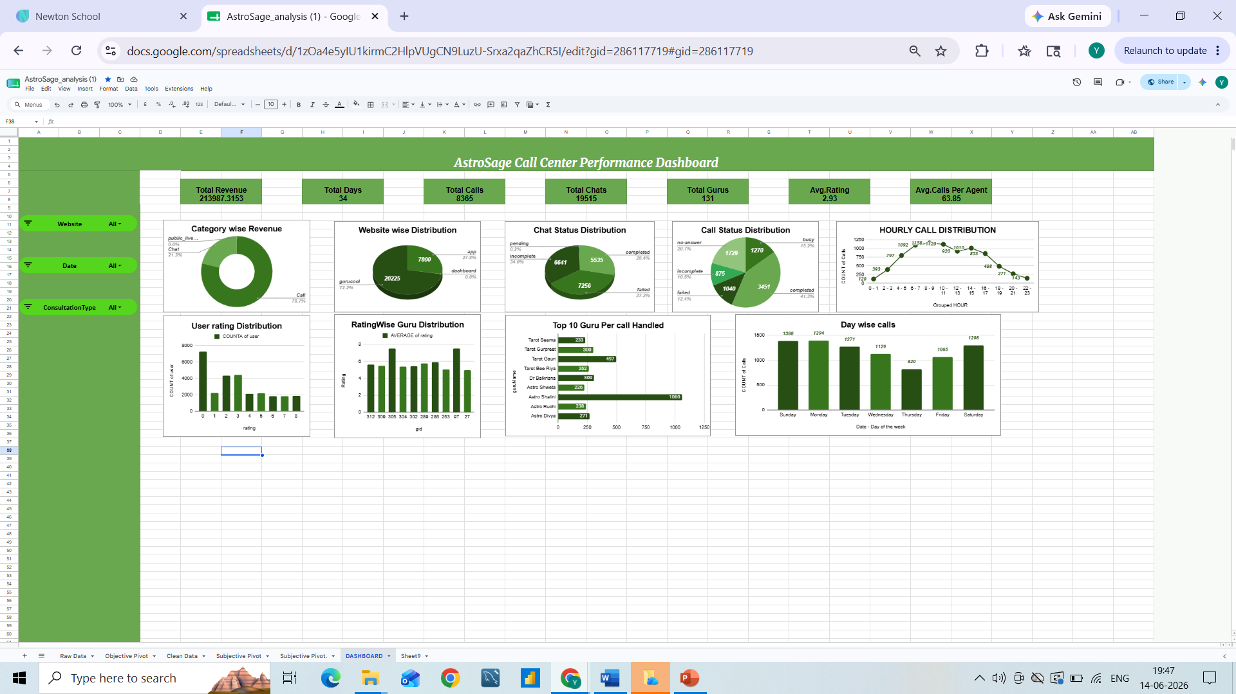
Call Center Performance Dashboard

Slide 20


